Slide 1
Floating Point Numbers Implementation
Group #4 CS152B Lab
Ho, Hing Kei
Vega, R. Javier
Yu, Wei

Slide 2
Number Representation
Floating Point Numbers
Three parts: sign (s), mantissa (F), exponent (E)
Examples: Represent −364₁₀ as a floating point number:
If s =1 bit, F = 7 bits, E = 2 bits; range = ±127 × 2²²⁻¹ = ±1016
−364₁₀ = −1 × 91₁₀ × 2 ² = [1][1011011][10]₂
If s =1 bit, F = 6 bits, E = 3 bits; range = ±63 × 2²³⁻¹ = ±8064
−364₁₀ = −1 × 45₁₀ × 2 ³ = [1][101101][011]₂
Slide property of Savio Chau, CS151B UCLA Professor

Slide 3
Normalized Float Numbers
Example:
11111.1111 x 2⁴ => 1.11111111 x 2⁸
The idea is to shift left the float number to have only one digit dominant and the rest as mantissa.
Shifting left increases exponent.
Shifting right decreases exponent.

Slide 4
Floating Point Operations
Addition (Subtraction)
  Step 1: Align decimal point of the number with smaller exponent
  A = 9.999₁₀ × 10 ¹, B = 1.610₁₀ × 10 ⁻ ¹ ➔ 0.016₁₀ × 10 ¹
  Step 2: Add (subtract) mantissas
  C = A + B = (9.999₁₀ + 0.016₁₀) × 10 ¹ = 10.015₁₀ × 10 ¹
  Step 3: Renormalize the sum (difference)
  C = 10.015₁₀ × 10 ¹ ➔ 1.0015₁₀ × 10 ²
  Step 4: Round the sum (difference)
  C = 1.0015₁₀ × 10 ² ➔ 1.002₁₀ × 10 ²
Multiplication (Division)
  Step 1: Add (subtract) exponents
  A = 1.110₁₀ × 10 ¹⁰, B = 9.200₁₀ × 10 ⁻ ⁵, New exponent = 10 + (− 5) = 5
  Step 2: Multiply (divide) mantissas
  1.110₁₀ × 9.200₁₀ = 10.212₁₀
  Step 3: Renormalize the product (quotion)
  10.212₁₀ × 10 ⁵ ➔ 1.0212₁₀ × 10 ⁶
  Step 4: Round the product (quotion)
    10.212₁₀ × 10 ⁶ ➔ 1.021₁₀ × 10 ⁶
  Step 5: Determine the sign
  Both signs are + ➔ Sign of produce is +
Slide property of Savio Chau, CS151B UCLA Professor

Slide 5
IEEE 754 Floating Point Numbers
Single precision format:
sign
Exponent (biased)
Significand only (leading 1 is implicit)
Other formats: Double (64 bits), Double Extended (>80 bits), Quadruple (128 bits)
Maximize precision of representation with fix number of bits
  Gain 1 bit by making leading 1 of mantissa implicit. Therefore,
  Mantissa = 1 + significand, Value = (−1)^{s} × (1 + significand) × 2 ^{E}
Easy for comparing numbers
  Put sign bit at MSB
  Use bias instead of sign bit for exponent field
  Real exponent value = exponent – bias. Bias = 127 for single precision
  Examples: IEEE 754 Floating Point Number Value
  Exponent A = -126 00000001 (−1)^{s} × F × 2 ⁽¹⁻¹²⁷⁾ = (−1)^{s} × F × 2⁻¹²⁶
  Exponent B = 127 11111110 (−1)^{s} × F × 2 ⁽²⁵⁴⁻¹²⁷⁾ = (−1)^{s} × F × 2¹²⁷
  This is much easier to compare than having A = −126₁₀ = 10000010₂ and B = 127₁₀ = 01111111₂
Slide property of Savio Chau, CS151B UCLA Professor

Slide 6
Special Numbers in IEEE 754
Number Type
Sign Bit
Exponent
Nth bit
(Hidden)
Significand
NaNs
(Not a Number)
X
111...111
1
1xxx...xxx
SNaNs
(Signaling Not a Number)
X
111...111
1
Non-zero
0xxx...xxx
Infinities
±
111...111
1
0
Subnormals
(Very small numbers)
±
0
0
(denormalized)
positive n < 2^{N-1}
N=size of significand+1
Zeros
±
0
0
0
Note: NaNs is used to indicate invalid data and SNaNs is used to indicate invalid operations
Slide property of Savio Chau, CS151B UCLA Professor

Slide 7
Implementation Details
Format:
Sign = 1 bit, Mantissa = 11 bits + 1 implicit,
Exponent = 4 bits.
  [15] [14..11] [10..0] bits
  Maximum Representation:
    4095 * 2⁷ = +/- 524,160₁₀
  Minimum Spacing between each number:
  2 ^{minimum exponent = -8} = 0.00390625₁₀
  Zero = 0100000000000000
  One = 0000000000000000

Slide 8
Procedure to Add and Subtract
Look for smaller exp (aligning numbers) :
  Determine the correct distance between the two exponents, which could be positive or negative.
  Also determine which number to be shifted.
  Always add, so determine sign of second operand:
  minus negative number → add positive
  minus positive number → add negative

Slide 9
Procedure to Add and Subtract (cont.)
Determine sign and mantissa (carryout) of result:
If carryout = 1 and signA XOR signB = 1
sign = +, drop carryout
elsif carryout = 0 and signA XOR signB = 1
sign = -, keep carryout
else
sign = follow operand, keep carryout

Slide 10
Procedure to Add and Subtract (cont.)
Do 2’s compliment on the result as indicated by the sign
Renormalize number by shifting
Exponent of result = smaller exponent of operands +/- number of shifting in renormalization

Slide 11
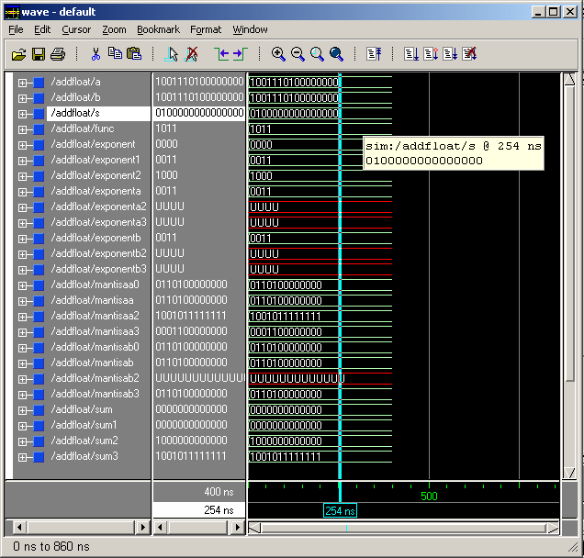
Simulation
Notes:
A and B are equal, subtracting them give us zero = 010000000…000

Slide 12
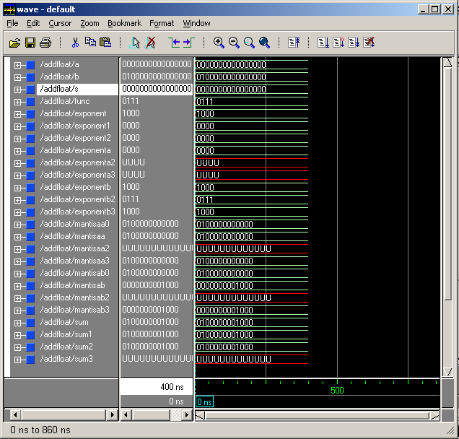
Notes:
One plus zero equal one

Slide 13
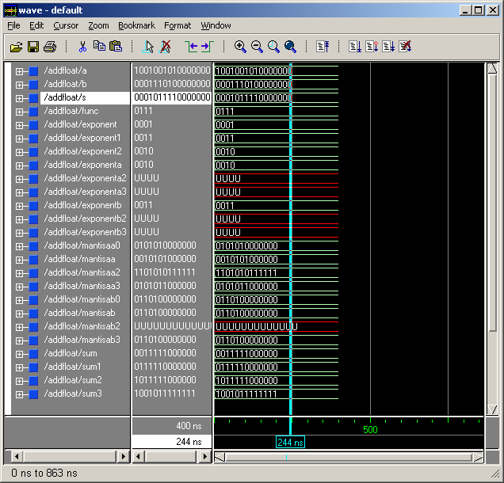
Notes:
Negative number adding a bigger positive number
A = -5.25
B = 13
S = 7.75

Slide 14
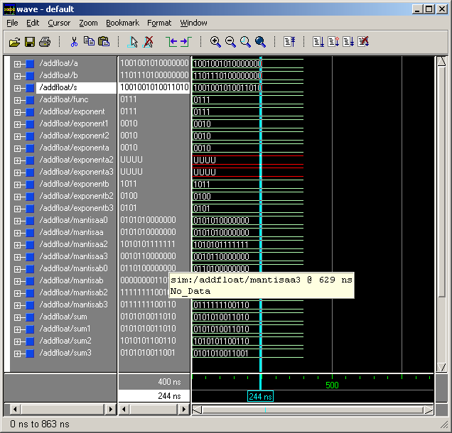
Notes:
Negative number add Negative number
A= -5.25
B= -0.1015625
S= -5.3515625

Slide 15
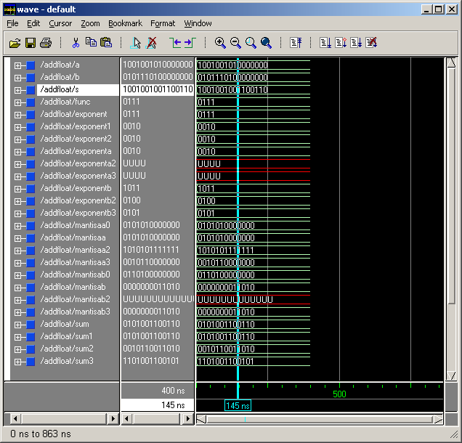
Notes:
Negative number add a smaller positive number
A = -5.25
B = 0.1015625
S = 5.3515625

Slide 16
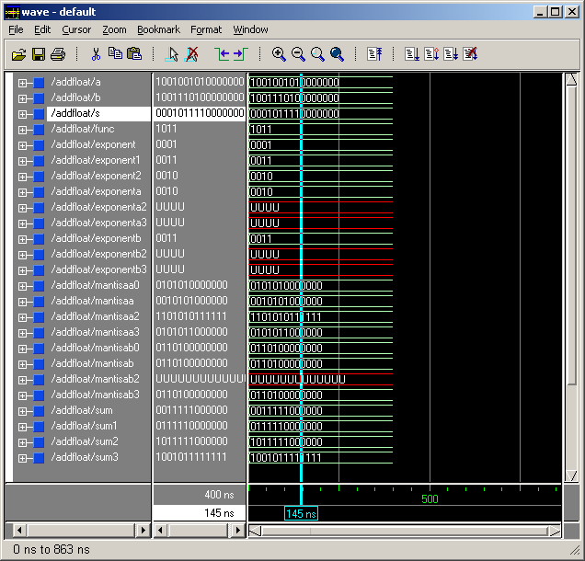
Notes:
Negative number subtract bigger negative number
A = -5.25
B = -13
S = 7.75

Slide 17

Notes:
Negative number subtract positive number
A = -5.25
B = 0.1015625
S = -5.3515625

Slide 18

Notes:
Negative number subtract smaller negative number
A = -13
B = -5.25
S =-7.75

Slide 19
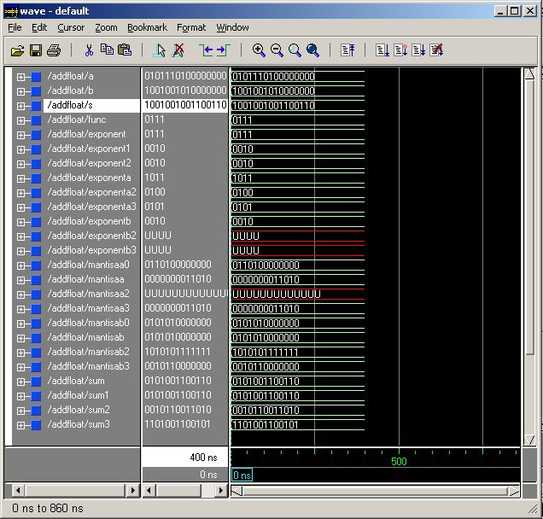
Notes:
Positive number add bigger negative
A = 5.25
B = -13
S = -7.75

Slide 20
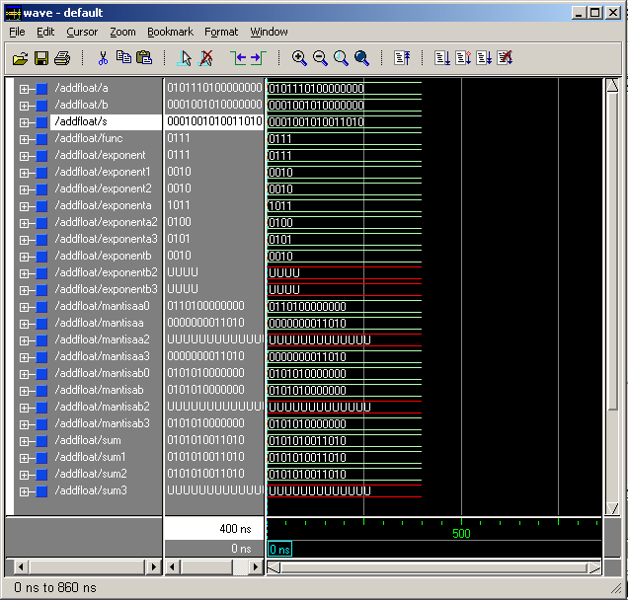
Notes:
Positive number add positive number
B = 5.25
A = 0.1015625
S = 5.3515625

Slide 21
        Thanks for everyone’s patient

